Slide 1
Advanced Inventor and the Design Process

Slide 2
Overview
Sheet Metal
Cable and Harness
Stress Test
Design Process
Publisher

Slide 3
Sheet Metal
Used for sheet metal and Lexan
.ipt file
Very easy to use
Tools
Flange
Hole
Face
Weldment
Open Inventor

Slide 4
Cable and Harness
Used to show cables and wires
Subsection of assembly
Creates its own .iam file
Pins
Create Segment
Open Inventor

Slide 5
Stress Test
Shows the force being applied at certain points of your part
Create Simulation
Loads
Constraints
Simulate
Open Inventor

Slide 6
CAD and Design Process
Design before you build
Find and Fix Problems
https://www.youtube.com/watch?v=HU3_N_emoks

Slide 7
Design Process
Rules and Regulations
Game Brainstorming
Approach to the game
Design Brainstorming
Design Matrix
Prototyping
Design Development
Project Development
Test and Trials
Refining

Slide 8
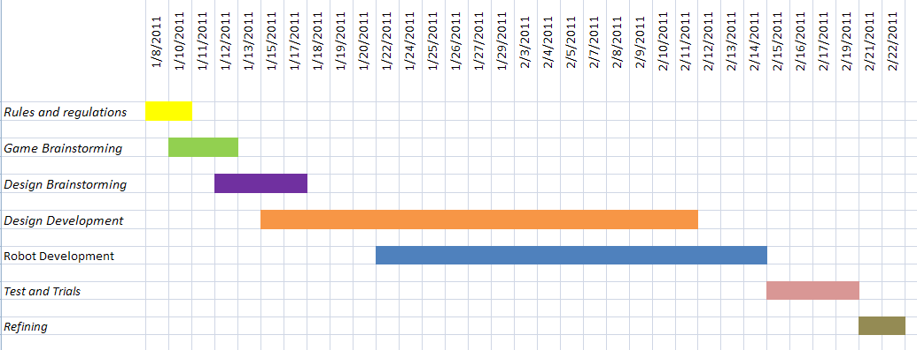
Gantt Chart

Slide 9
Rules and Regulations
Begins with Kickoff
Break into Teams
Read Game Manual

Slide 10
Game Brainstorming
Brainstorm strategy
List possible things for robot to do
Rank importance of each task
Narrow strategies based on priorities

Slide 11
Design Brainstorming
Brainstorm robot systems
Sketches
Whiteboards and Group Discussion
List all Design Solutions
Use design matrices
Do for each major system (drive train, shooter, ect.)

Slide 12
Design Development
CAD
Work out the details
Dimensions and Component Placements
Find and Fix Errors
Design Specialty Parts

Slide 13
Project Development
Build Robot
Based on CAD
Cut parts to specification
IDWs
Make Specialty Parts

Slide 14
Tests and Trials
Test Major Components
CAD and make any changes

Slide 15
Refining
Tweak components
Refine Robot

Slide 16
Design Process Tips
Make extensive use of subassemblies
Don’t argue too much
Stay focused on completing the task

Slide 17
Inventor Publisher
Creates presentations out of your Inventor files
Required for the current Autodesk Excellence of Design Award

Slide 18


Slide 19
Inventor Publisher Tutorial
Storyboard
Snapshot
Text
Explode
Styles

Slide 20
Your FIRST Presentation
If you were in the earlier lesson, you will be using your LEGO project
Otherwise use the castle found at Q:\Advanced Inventor and the Design Process\Castle.iam
Now follow the instructions we give you

